Slide 1
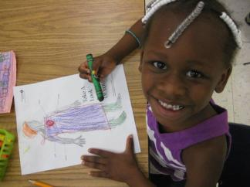
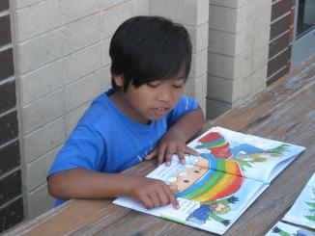
PUTTING SUCCESS
INTO WORDS
Y Readers
Charlotte, NC
1
| Y READERS | ©2012 YMCA OF GREATER CHARLOTTE

Slide 2
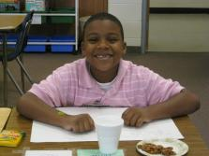
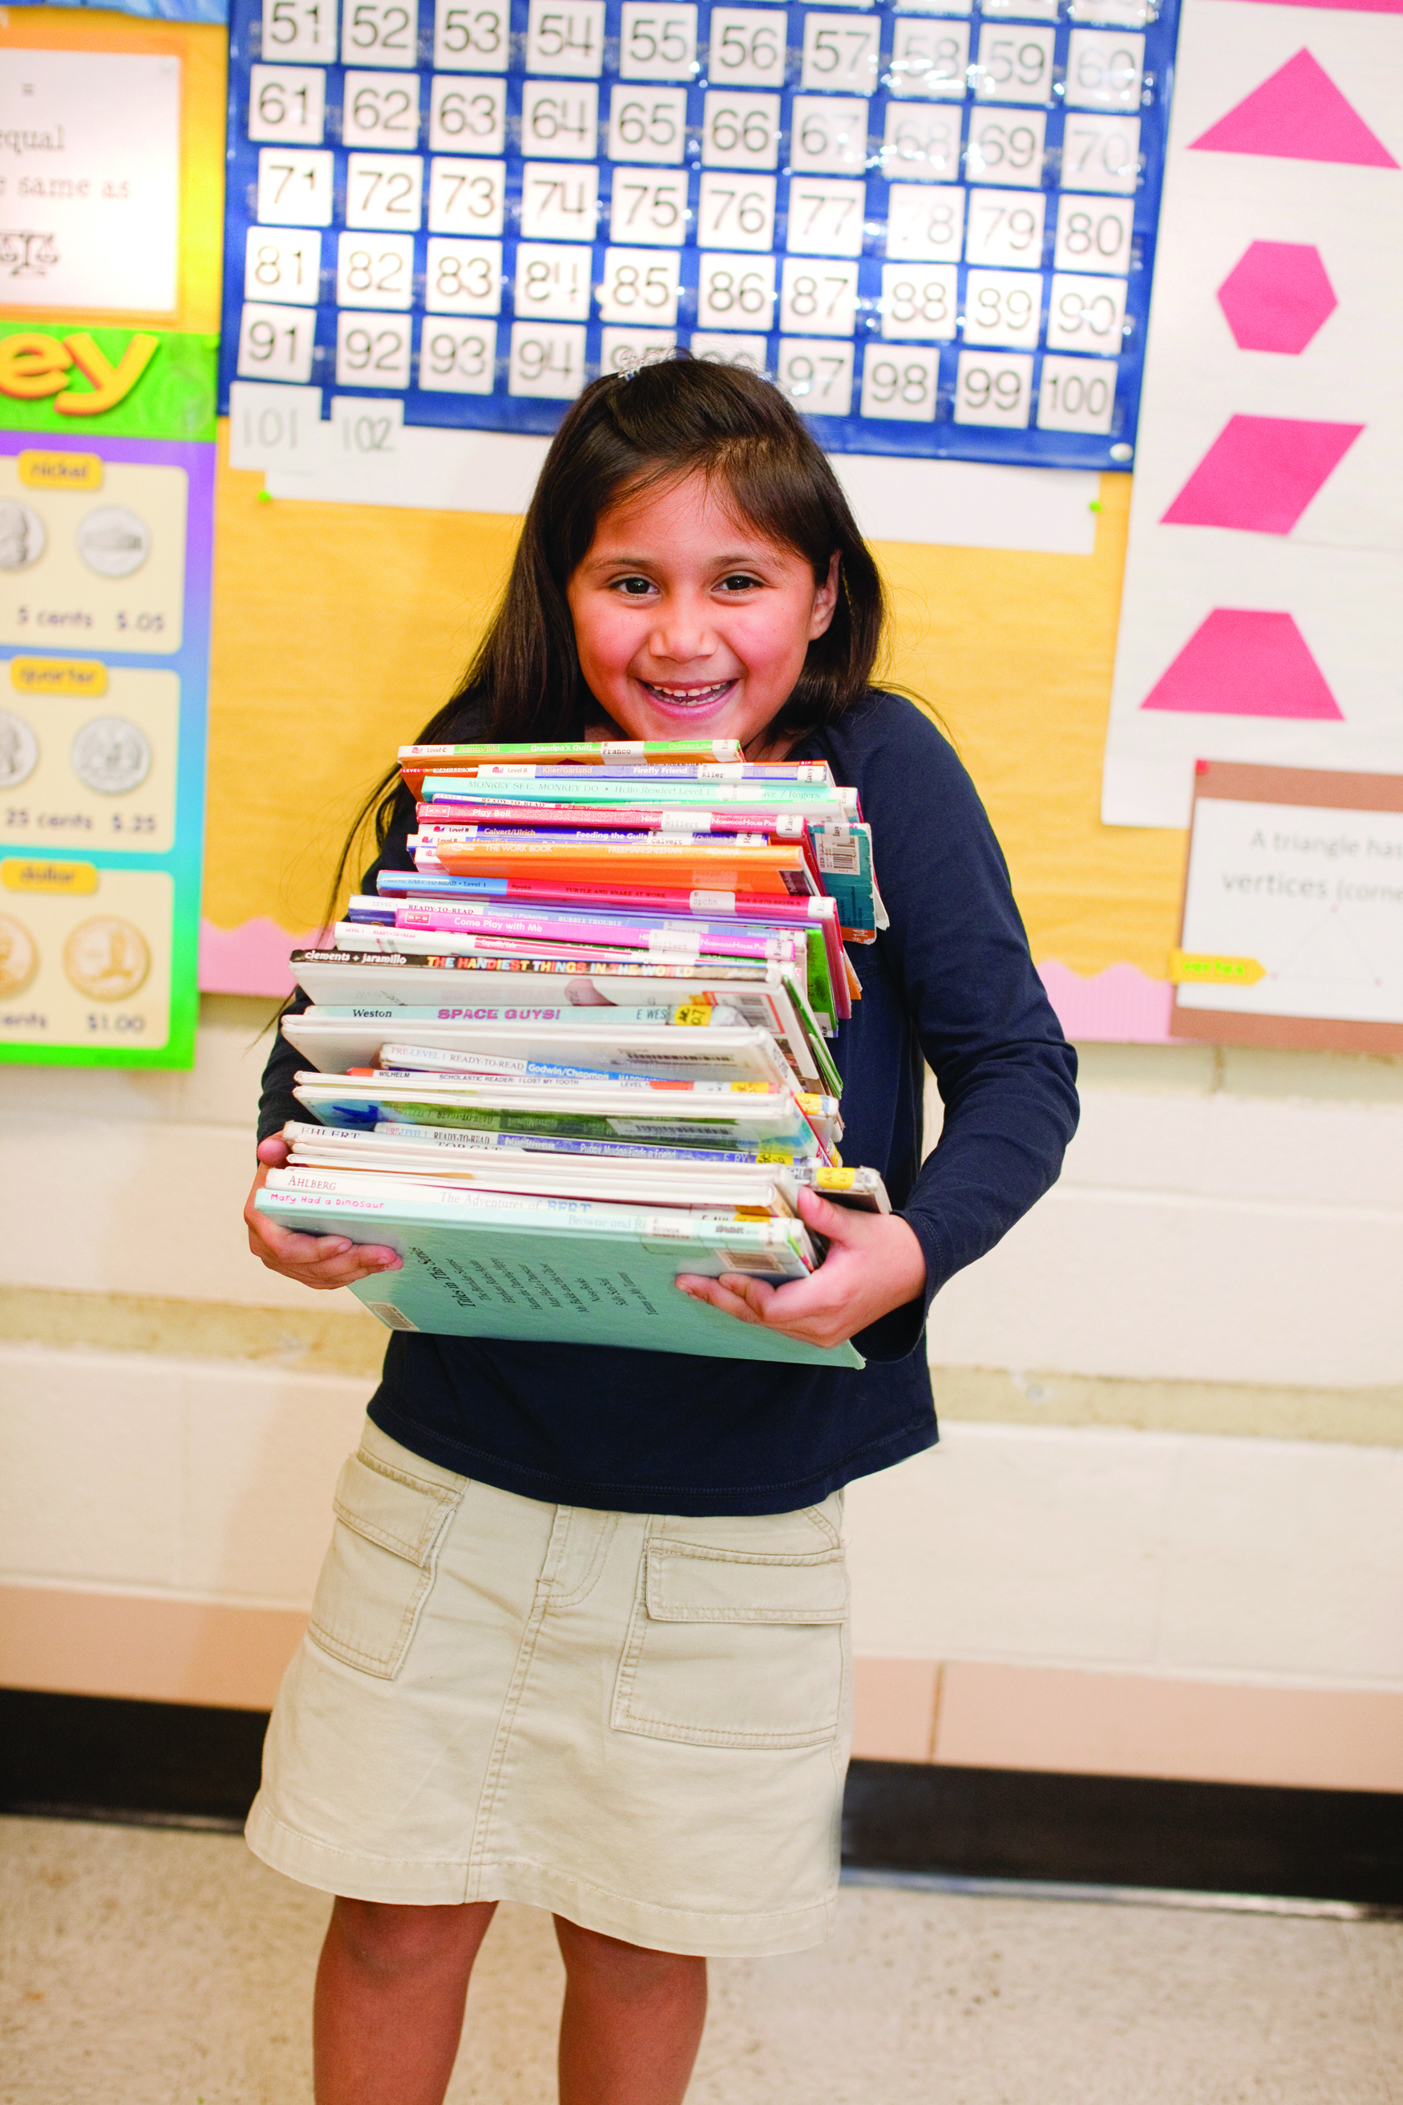
PROGRAM OVERVIEW
Purpose
  To improve the literacy skills and self-confidence of students currently reading below grade level.
  Origin and History
  The program began in the summer of 1999 as Project Starfish by the YMCA of Greater Charlotte in partnership with Charlotte-Mecklenburg Schools.
  The program has grown from serving 40 students in one school to serving nearly 500 students across three school districts.
  Y Readers expanded in 2004 to include afterschool programming.
  Collaboration
  Y Readers involves the collaboration of school districts, school administrators, YMCA branches, funders, parents, staff, and community volunteers.

Slide 3
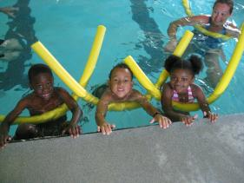
PROGRAM COMPONENTS
Literacy Support
  Y Readers follows the Four-Blocks literacy model which includes Guided Reading, Self-Selected Reading, Writing, and Working with Words.
  During the afterschool program, students receive 80-100 minutes of literacy instruction three days per week.
  Certified teachers and teacher assistants are responsible for planning and implementing lessons that follow the Four-Blocks framework. Teachers strive to teach literacy skills in creative ways to ensure that students are engaged in learning.
  Enrichment Activities
  Enrichment activities are a core part of the Y Readers program.
    Swimming
    Health Education
    Art, Music, and Drama
    Character Education
    Science
3
| Y READERS | ©2012 YMCA OF GREATER CHARLOTTE

Slide 4
Program impact
This past summer 456 students completed the six-week literacy program at 13 sites.
We are currently serving 192 students at six school sites in the afterschool program.
Students raised their reading proficiency scores by an average of 6 months during the 2011-2012 afterschool program.
Students raised their reading proficiency scores by an average of 3 months during the summer of 2012. 88% of students maintained or improved their reading level.

Slide 5
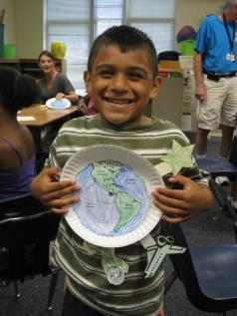
THE POPULATION WE SERVE
Y Readers afterschool sites are located in Title I schools across the greater Charlotte region (75% or more are considered economically disadvantaged).
Students are selected by teachers and principals based upon academic need. The program targets “strategic” students that need an additional push in literacy skills to perform on grade level.
We currently serve 1st , 2nd, and 3rd grade students.
Based upon economic and family situations, many students that we serve live in unstable housing situations.
Each year, the number of second language learners increases in the community and within our program.
5
| Y READERS | ©2012 YMCA OF GREATER CHARLOTTE

Slide 6
PARENT CHALLENGES
Access to technology at home
Access to books and other literacy materials at home
Limited opportunities for enrichment
Education and literacy level of parents
Language barrier
Understanding and navigating the school system
Retention
Transportation
Continuum of service
6
| Y READERS | ©2012 YMCA OF GREATER CHARLOTTE

Slide 7
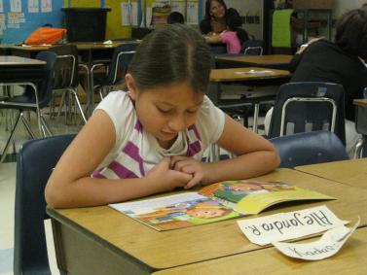
CONSIDERATIONS FOR SECOND LANGUAGE LEARNERS
Cultural awareness
Translation services
Bilingual staffing
Staff ratio and volunteers
Program cost
Enrollment information
7
| Y READERS | ©2012 YMCA OF GREATER CHARLOTTE

Slide 8
Components OF PARENT ENGAGEMENT
Parents are the first and most influential teachers our students will ever have.
Program Engagement
School and Community Engagement
Parent Engagement

Slide 9
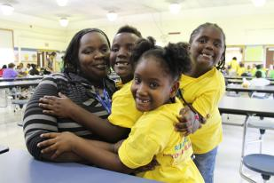
PROGRAM ENGAGEMENT
  Y Readers parents are purposefully and regularly asked to participate in the daily work of educating their children.
  Each parent:
  Attends an orientation to learn more about the program and receive a copy of the parent handbook.
  Pledges to read each night
  with their child.
  Attends workshops to learn
  about ways to support student achievement.
  Receives frequent communication via newsletters and face to face interaction with Y Readers staff.
  Commits one hour of volunteer service in the Y Readers classroom.
9
| Y READERS | ©2012 YMCA OF GREATER CHARLOTTE

Slide 10
SCHOOL AND COMMUNITY ENGAGEMENT
Referrals to other support programs within the YMCA and broader community [PAT, Getting Ahead, Social Services]
Summer membership at a YMCA branch
Workshops focused on advocacy and how to collaborate with school personnel
Parent advisory council is currently being formed to determine additional parent needs

Slide 11
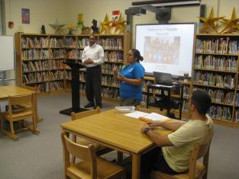
PARENT EDUCATION
  Parent Workshops
  Topics:
  Reading strategies
  Make and take literacy activities
  Health and wellness
  Advocating for your child
  How to help your child if you are not a strong reader
  Considerations:
  Time of day
  Translation
  Length of program
  Dinner and childcare provided
11
| Y READERS | ©2012 YMCA OF GREATER CHARLOTTE

Slide 12
LISTENING TO PARENTS
YMCA Net Promoter Survey
94.3% of parents surveyed would recommend the Y Readers program to a friend or family member
“My kids have taken part in both the after-school and summer programs. Both my kids had a great time with the program. I like the Readers program because my kids are not just playing around, they're having fun, but they're learning too.”
Daily communication
Responding to individual family needs

Slide 13
THANK YOU! QUESTIONS?
Yolanda R. Bynum
Sr. Program Director of school Age Initiatives, Community Development
Yolanda.bynum@ymcacharlotte.org
704-716-6364
Amanda Wilkinson
Program Coordinator of School Age Initiatives, Community Development
Awilkinson@ymcacharlotte.org
704-716-6307
Blair Campbell
Resource Coordinator, Community Development
Blair.campbell@ymcacharlotte.org
704-716-6365
13
| Y READERS | ©2012 YMCA OF GREATER CHARLOTTE

